Slide 1
0x301 – Reverse Engineering
ECED4406 – Computer Security
Dr. Colin O’Flynn
Dalhousie University.

Slide 2

Forward Engineering?
Taking a problem, designing solution to that problem.
Understanding the underlying requirements.
Using well documented design documents (datasheets etc).

Slide 3
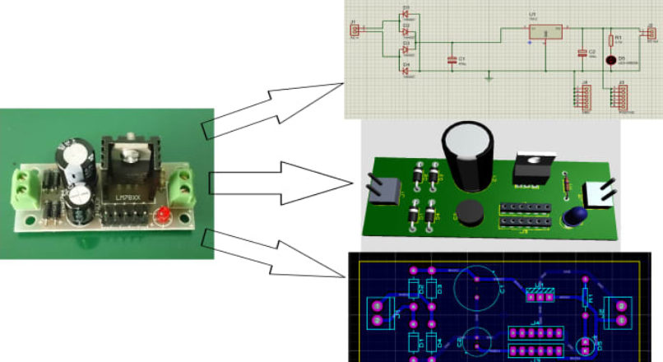
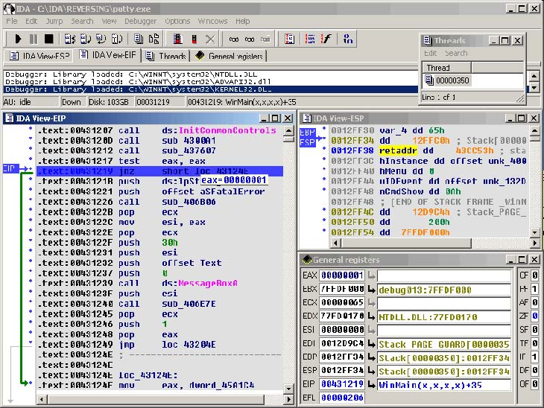
Reverse Engineering
Going from final product to some form of design documentation.
Datasheets???

Slide 4
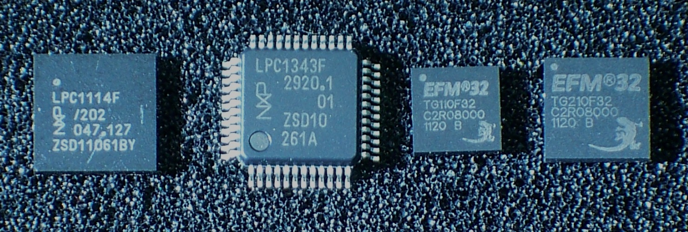
Software Reverse Engineering
Software reverse engineering is common requirement as part of security research.
We will focus in particular on Arm Cortex-m language reverse engineering in this section of the course.
https://en.wikipedia.org/wiki/ARM_Cortex-M#/media/File:ARM_Cortex-M0_and_M3_ICs_in_SMD_Packages.jpg

Slide 5
Finding General Information
You can often find information through various sources without touching any hardware:
FCCID Filings
Technical Manuals
Firmware from the manufactures website

Slide 6
FCC-ID Markings
Federal Communications Commission (FCC) requires compliance with various rules if you release a product with Radio Frequency (RF) communications in the market. This is to avoid RF interference between devices.
As part of a product being certified, various information becomes publicly available, including internal photos.

Slide 7
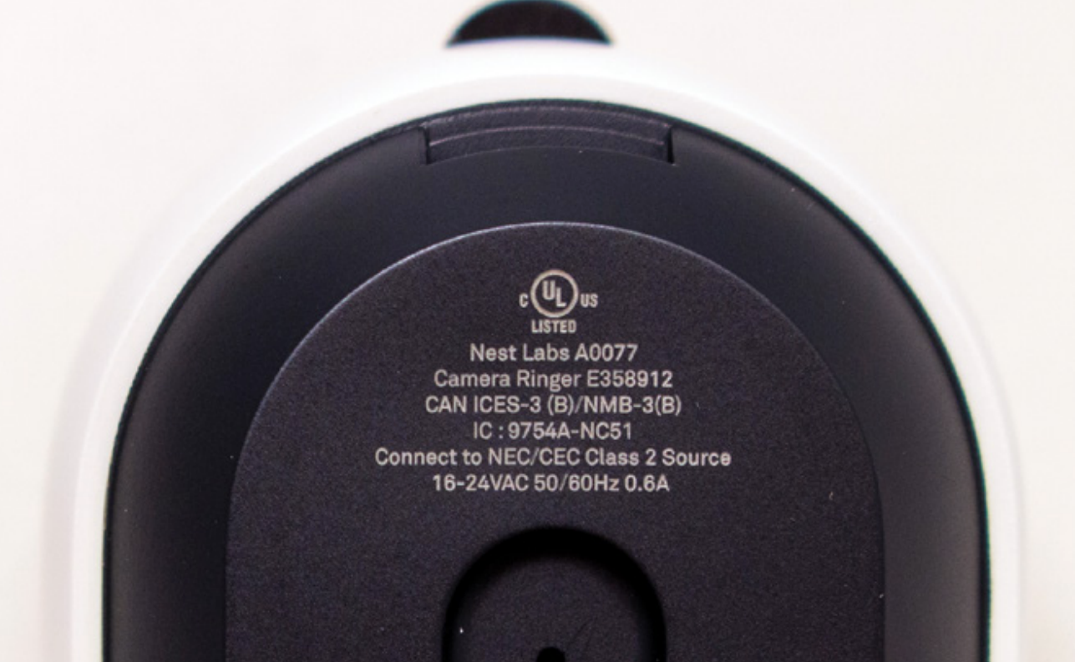
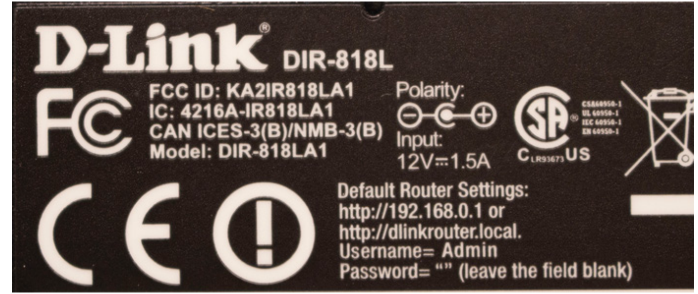
FCC-ID Markings
This only has the Canadian “IC code”, which is often similar to the FCCID

Slide 8
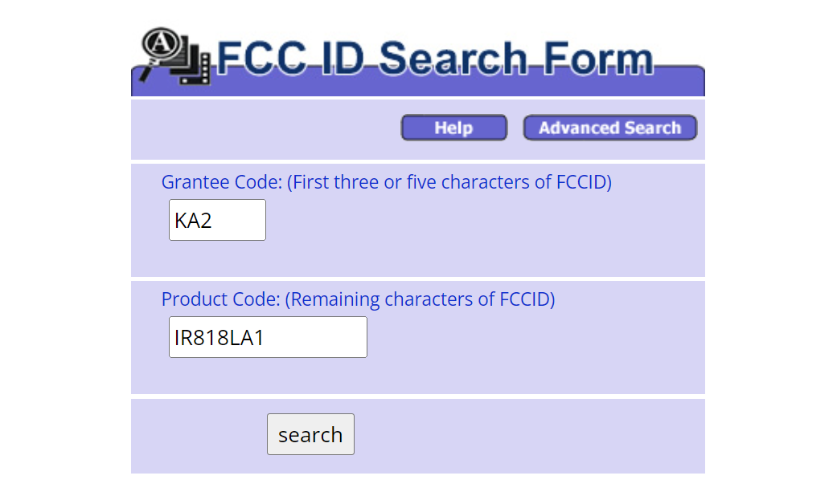
Example of Searching FCC-ID Code
E.g., from last slide, FCC-ID is KA2IR818LA1
Go to https://www.fcc.gov/oet/ea/fccid

Slide 9
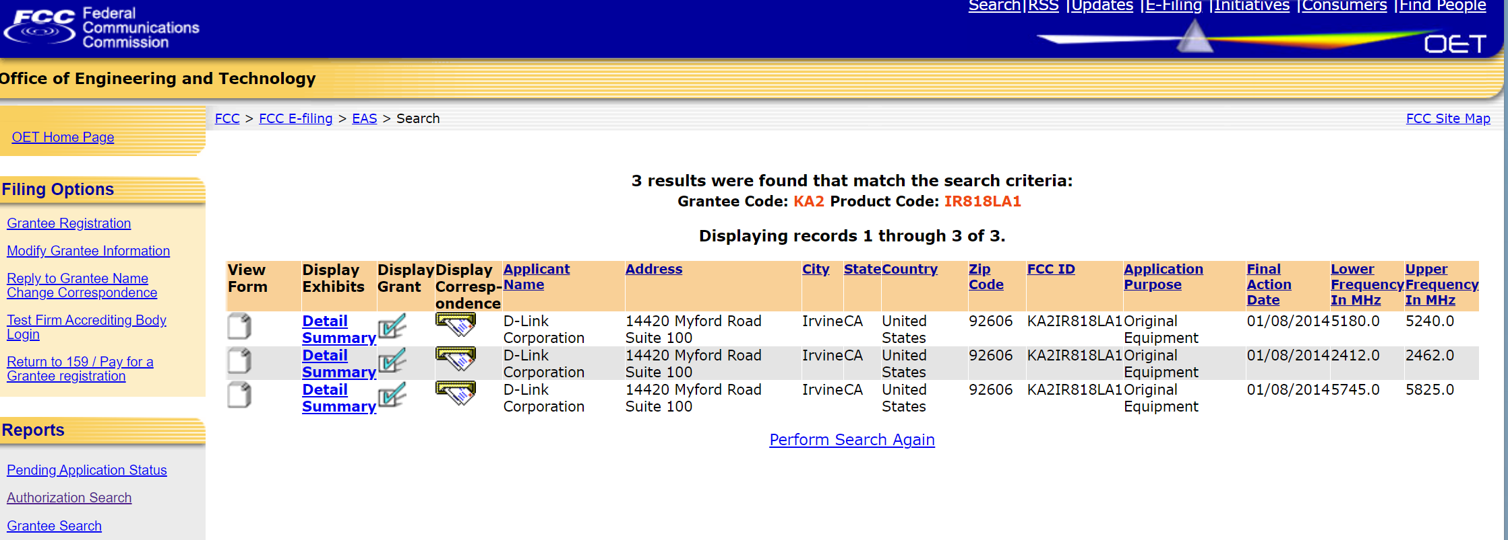

Slide 10
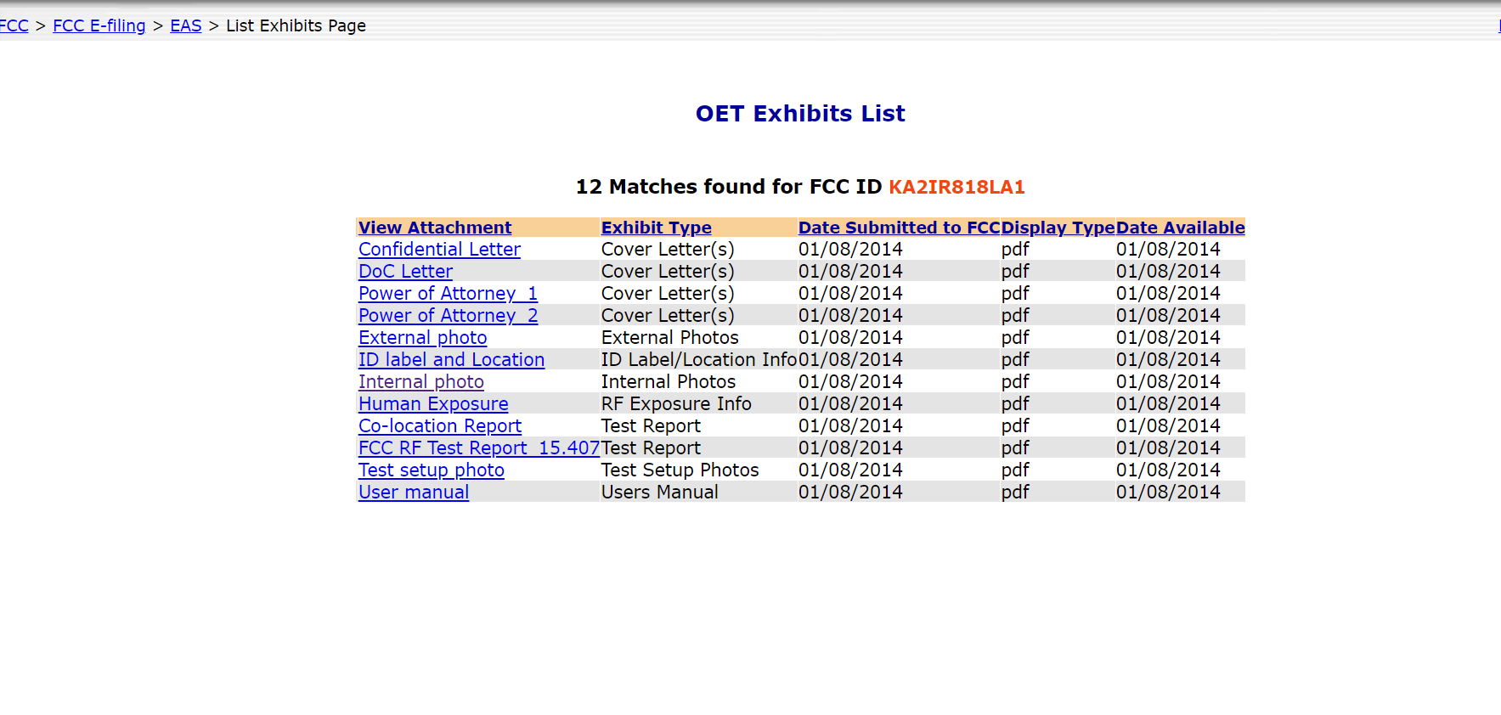
Click “Detail” link

Slide 11
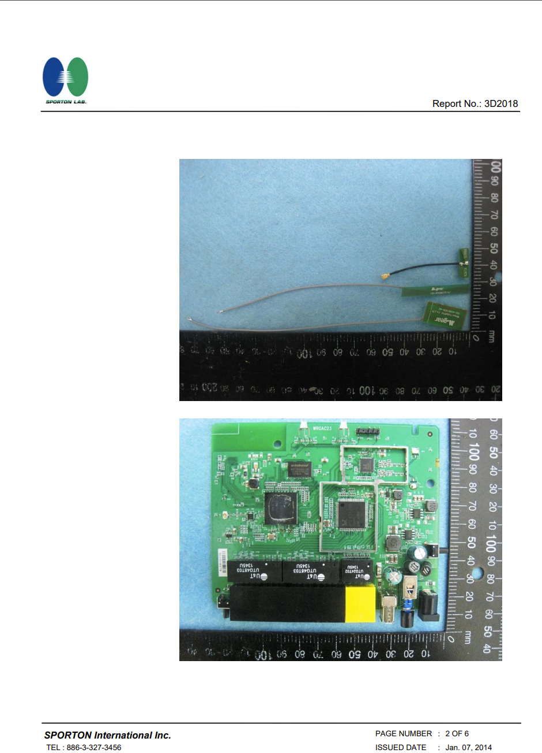
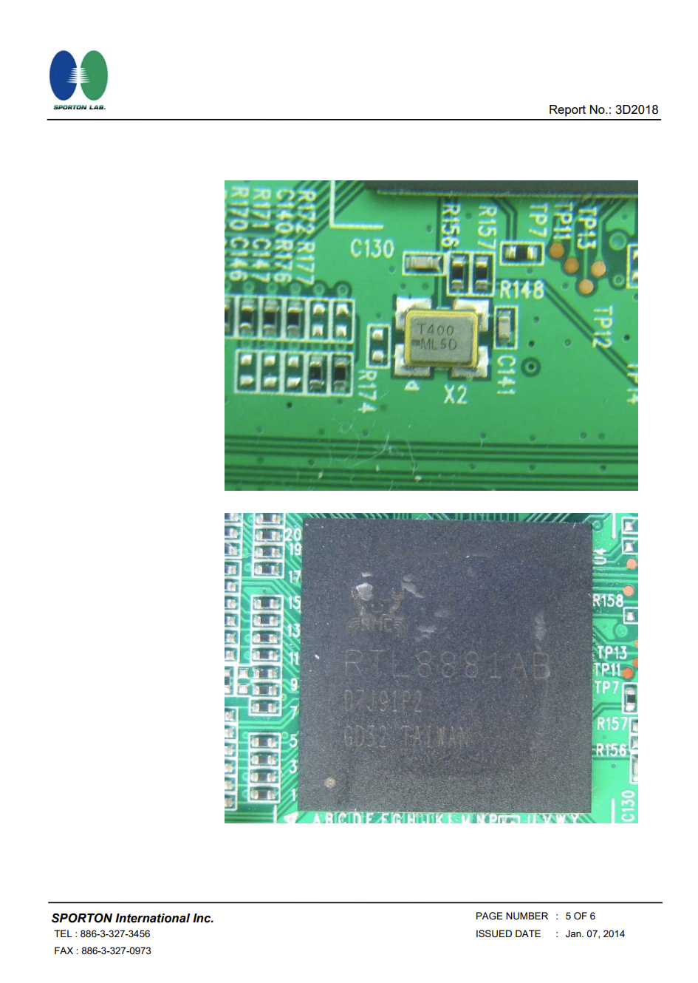
Click “Internal Photos” Link
https://apps.fcc.gov/eas/GetApplicationAttachment.html?id=2159924

Slide 12
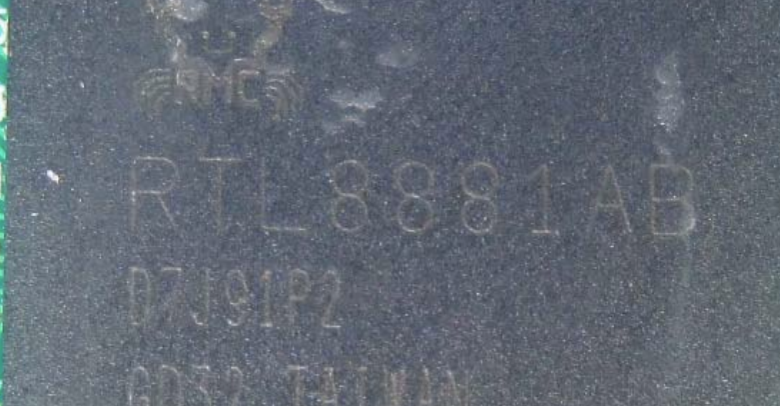
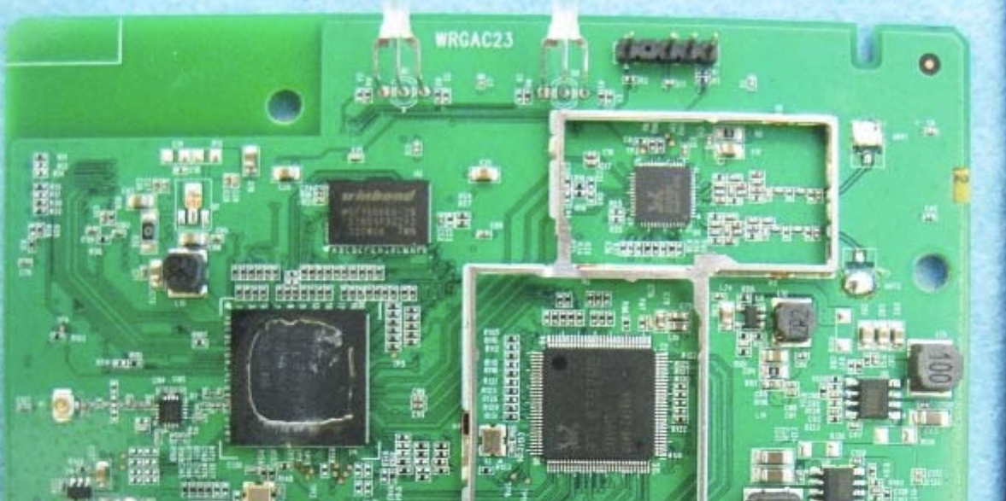
What do we learn from these photos?
Part number of the main microprocessor
A header (often this is a “serial port”)

Slide 13
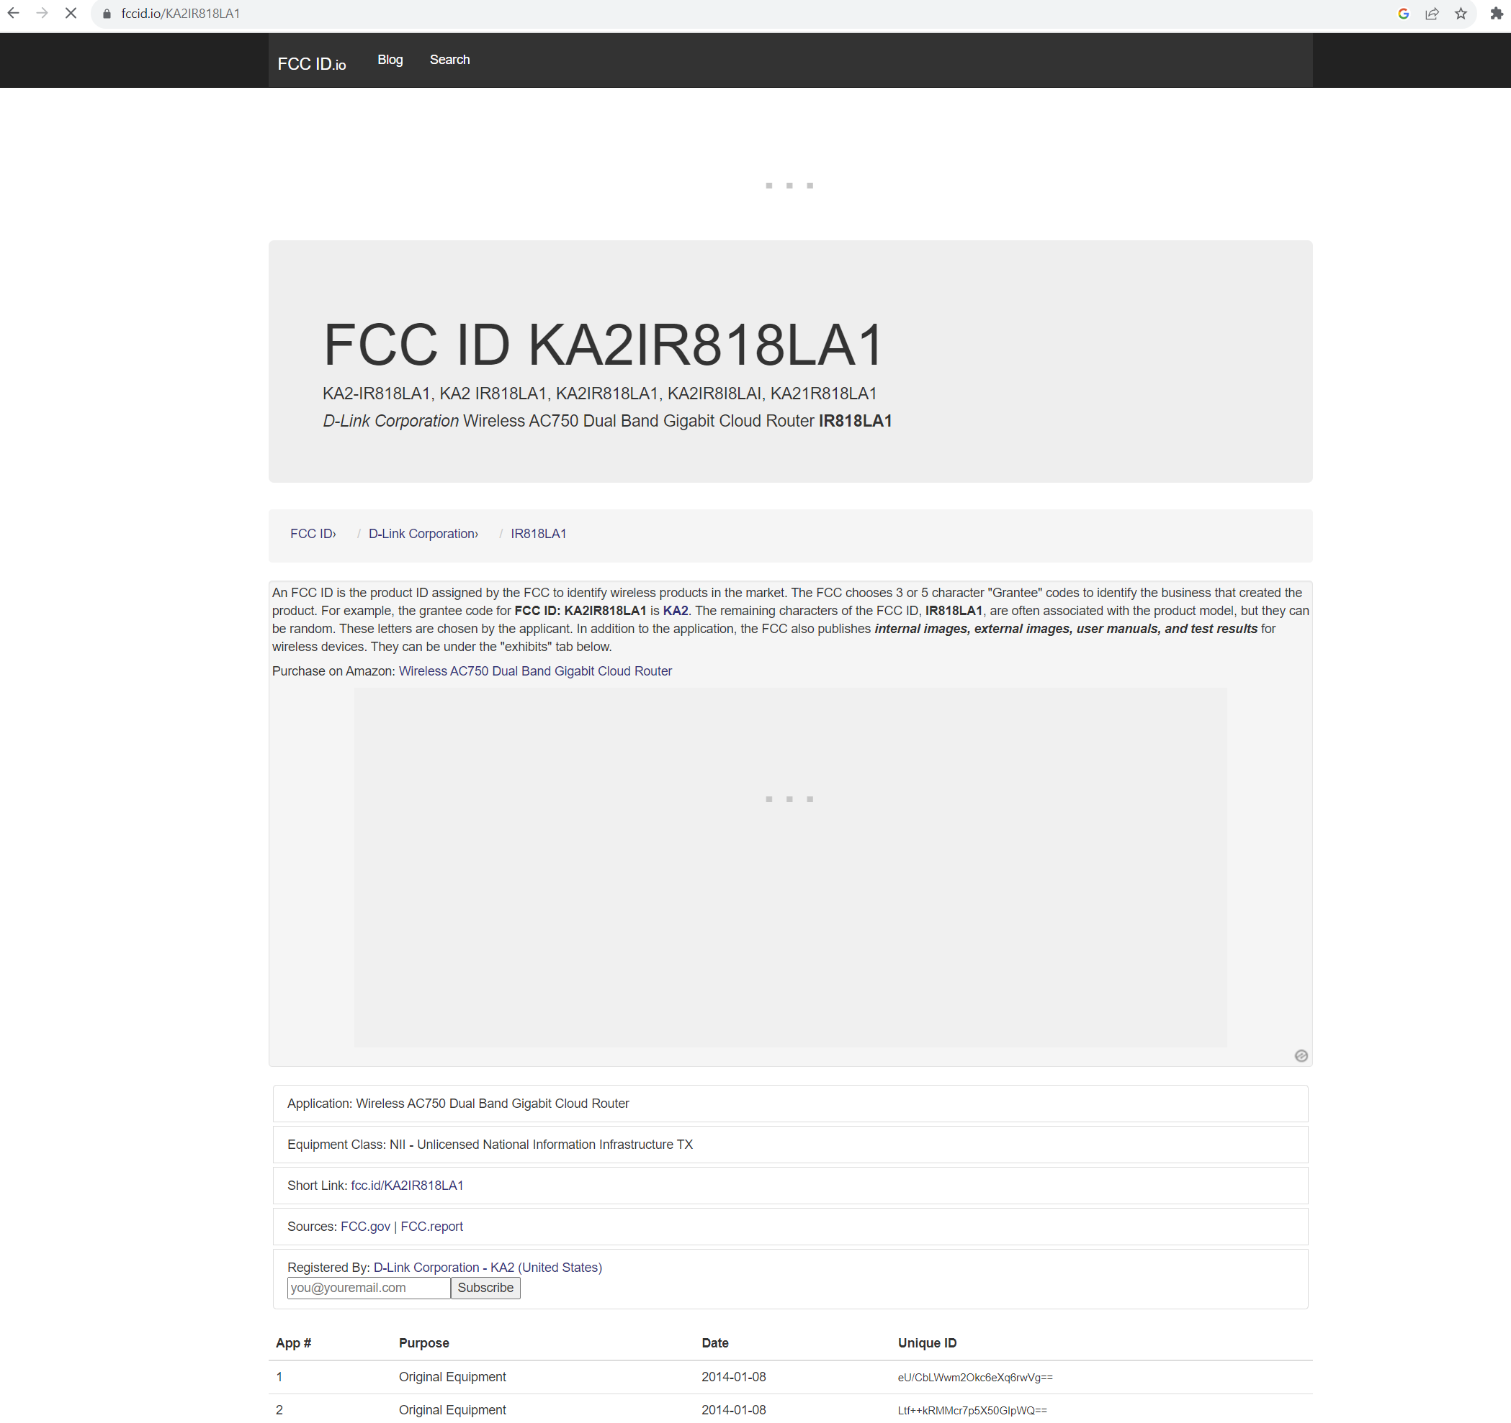
Sidenote: Using FCCID.IO
The “fccid.io” website has a better search & interface, you might want to have an ad blocker when using the website however…

Slide 14
Firmware from Websites
Firmware is the software running on these devices. We can read the firmware directly from the device, or we can sometimes find it in the “firmware update” section of websites.
The firmware may be in a non-standard format, or may be encrypted, etc. But it may be simply “plain text”.

Slide 15
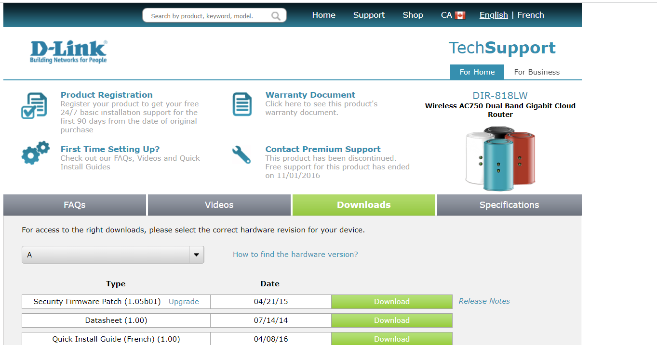
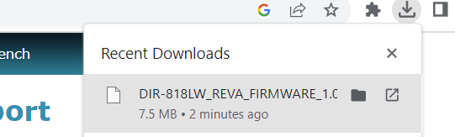
Example: DIR-818 Router from previous slides
Go to https://support.dlink.ca/ProductInfo.aspx?m=DIR-818LW

Slide 16
Looking at Firmware Images
Looking for “strings” in binary image, use “strings” command-line tool (Linux/WSL):
$ strings -n 20 DIR-818LW_REVA_FIRMWARE_1.05B01.BIN
signature=wrgac23_dlob.hans_dir818l
Jdev=/dev/mtdblock/6
Data may be encoded but not encrypted, can use another tool such as binwalk that looks for known patterns in the binary file.

Slide 17
Binwalk
See pages 111 to 116 of The Hardware Hacking Handbook for more information
Binwalk has many options, but to provide an initial sweep is as easy as:
$ binwalk DIR-818LW_REVA_FIRMWARE_1.05B01.BIN
DECIMAL HEXADECIMAL DESCRIPTION
--------------------------------------------------------------------------------
0 0x0 DLOB firmware header, boot partition: "dev=/dev/mtdblock/6"
112 0x70 LZMA compressed data, properties: 0x5D, dictionary size: 33554432 bytes, uncompressed size: 5239896 bytes
1638512 0x190070 PackImg section delimiter tag, little endian size: 12606976 bytes; big endian size: 6209536 bytes
1638544 0x190090 Squashfs filesystem, little endian, version 4.0, compression:lzma, size: 6207939 bytes, 2273 inodes, blocksize: 131072 bytes, created: 2015-04-19 10:03:22

Slide 18
Binary → Reverse Engineering
Generally once we have the binary we’ll work on reverse engineering the software.
Reverse Engineering the software will be a topic for future lectures, for now let’s learn how to get firmware and related information from the hardware…

Slide 19
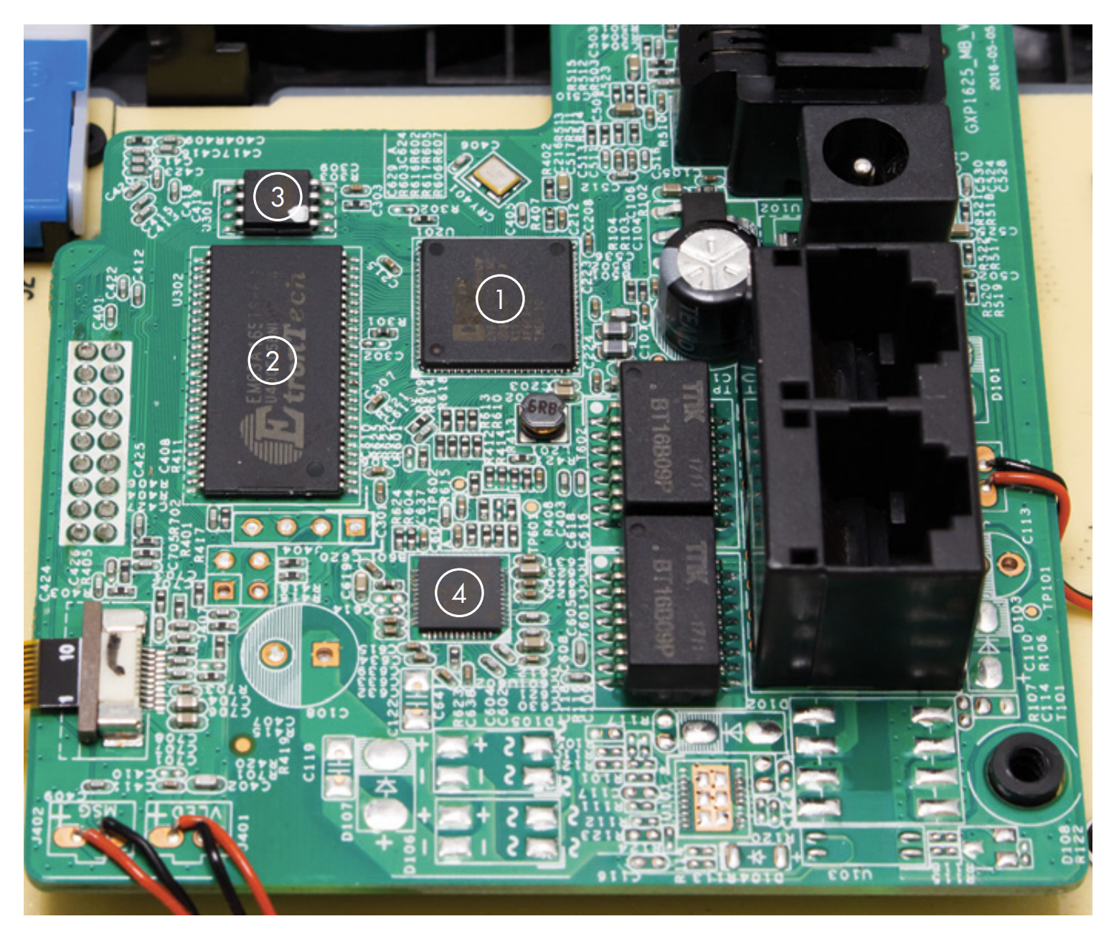
Typical IoT / Hardware Board (This is a VOIP Phone)
1: DVF97187AA2ANC
2: EM63A165TS-6G
3: 25Q128JVSQ
4: RTL8304MB

Slide 20
Typical IoT / Hardware Board
Of these – the most interest would probably be the IC, 25Q128JVSQ.
This is a “SPI Flash Chip”, and we can “dump” this chip to get a firmware image.

Slide 21
Further Readings & Examples
See Chapter 3 of the Hardware Hacking Handbook for more examples of decoding and understanding devices can be done.

Slide 22
Next Steps in Reverse Engineering
Working with interfaces on the board to interact with firmware.
Reading out firmware if couldn’t “simply” download it.
Actual process of reverse engineering the software (normally with goal of bypassing some security feature or similar).

